Slide 1
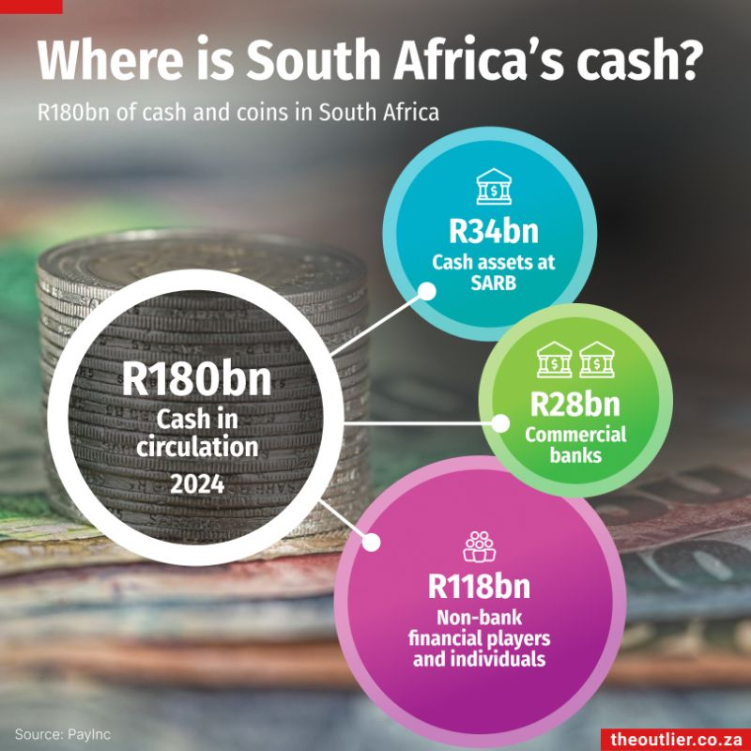
Mzansi Opportunity Wallet
The Problem We Cannot Ignore
32.7%
official unemployment in Q1 2026
8.1m
unemployed people in Q1 2026
45.6%
youth aged 15-34 not in work, education, or training
Core problem
Many young South Africans can work, but they lack trusted access to opportunities, references, transport/data money, and formal income records.
South Africa does not only have an unemployment problem. It has a trust, access, and visibility problem.
Informal earnings often stay invisible to banks, employers, landlords, and insurers.
The missing bridge is trust: verified identity, safe payment, and proof of reliability.
A bank can help convert capability into recognised economic activity.
Notes:
I want to focus on a problem that is deeply South African: youth unemployment and income instability. The issue is not only that jobs are scarce. It is also that many young people cannot prove reliability, cannot access short-term work safely, and cannot convert small earning moments into a financial identity.

Slide 2
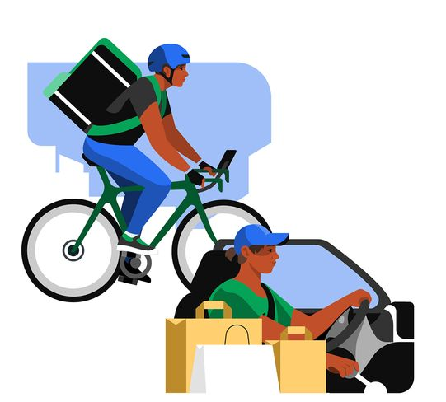
Inspiration From Another Industry Borrowing from ride-hailing and marketplace platforms.
Marketplace trust model
Verified identity
Ratings and completed transaction history
Transparent pricing
Payment protection
Dispute process
Banking translation
Match young people to verified earning opportunities
Protect payment until work is completed
Turn each job into a reputation signal
Use verified earnings to unlock financial access
Notes:
The innovation is not to copy Uber. It is to borrow the trust design. Marketplaces make strangers comfortable transacting with each other. A bank can do the same for work, payment, and financial access.

Slide 3
The Innovation - Mzansi Opportunity Wallet A bank-owned wallet that turns small jobs into financial visibility
Verify
Bank-verified profile using KYC/FICA, skills, location, and references
Match
Connect users to gigs, SME work, learnerships, and township business support
Protect
Hold payment safely and release it when work is completed
Record
Every completed job becomes a verified earning event
Finance
Responsible advances for transport, data, tools, stock, or certification
Example journey
A young person gets a weekend retail shift, receives a small transport/data advance, completes the job, is paid instantly, and builds a verified work history.
Opportunity creates earnings. Earnings create proof. Proof creates trust. Trust unlocks more opportunity.
Notes:
A young person gets a weekend retail shift, receives a small transport/data advance, completes the job, is paid instantly, and builds a verified work history.
The product creates a loop: opportunity creates earnings, earnings create proof, proof creates trust, and trust unlocks more opportunities and better banking access.

Slide 4
Why The Bank Should Do This This is not charity. It is a new financial ecosystem.
Why a bank is uniquely positioned
Banks already verify identity.
Banks already move money safely.
Banks already manage risk.
Banks already serve SMEs and corporates.
Banks can turn income behaviour into responsible financial access.
How the bank benefits
New youth customers at the start of their financial lives.
More deposits, transactions, and payment activity.
Better alternative data for safer credit decisions.
Stronger SME and corporate relationships.
Responsible growth in micro-credit, insurance, savings, merchant services, and business accounts.
Notes:
The bank benefits because informal earning becomes formal financial activity. Today, many young people are invisible to the formal financial system. This gives the bank verified data, customer loyalty, and a new way to grow responsibly.

Slide 5
MVP, Safeguards, And Impact Start small, prove trust, then scale
MVP
Pilot in one metro or township corridor
Start with retail shifts, home services, and township business support
Partner with SMEs, franchises, municipalities, NGOs, and corporate supplier-development programmes
Safeguards
POPIA-compliant consent and data use
Verified employers and fair minimum pay bands
Clear dispute process and transparent scoring
Affordability checks before credit
Impact Metrics
Verified earning events created
Repeat hiring rate
Payment dispute rate
Micro-advance repayment rate
Users graduating into fuller banking products
South Africa does not only needs more bank accounts. It needs more people becoming economically visible.
Mzansi Opportunity Wallet turns the bank into a trusted bridge between talent, work, payment, and financial inclusion.
Notes:
South Africa does not only need more bank accounts. It needs more people becoming economically visible. Mzansi Opportunity Wallet turns the bank into a trusted bridge between talent, work, payment, and financial inclusion.

